Slide 1
Git and Github By Given Sichilima

Slide 2
Highlights
Introduction to Git
Git Repository Structure
Github
Accessing Github central repository via HTTPS or ssh
Working with git – Important Git commands

Slide 3
Git
Git is a distributed version control system. So,
What is a Version Control System?
A version Control system is a system that maintains different versions of your project when we work in a team or as an individual.
(system managing changes to files) As the project progresses, new features get added to it.
So, of your project for you and you can roll back to any version you want without causing any trouble to you for maintaining differea version control system maintains all the different versions nt versions by giving names to it like MyProject, MyProjectWithFeature1, etc.

Slide 4
Distributed Version control system means every collaborator(any developer working on a team project)has a local repository of the project in his/her local machine unlike central where team members should have an internet connection to every time update their work to the main central repository.
So, by distributed we mean: the project is distributed.
A repository is an area that keeps all your project files, images, etc. In terms of Github: different versions of projects correspond to commits.

Slide 5
Git Repository Structure
It consists of 4 parts:
Working directory: This is your local directory where you make the project (write code) and make changes to it.
Staging Area (or index): this is an area where you first need to put your project before committing. This is used for code review by other team members.
Local Repository: this is your local repository where you commit changes to the project before pushing them to the central repository on Github. This is what is provided by the distributed version control system. This corresponds to the .git folder in our directory.
Central Repository: This is the main project on the central server, a copy of which is with every team member as a local repository.

Slide 6
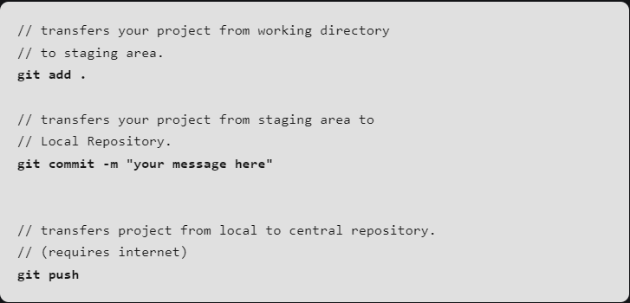
All the repository structure is internal to Git and is transparent to the developer.

Slide 7
Git– A few Operations & Commands
Some of the basic operations in Git are:
Initialize
Add
Commit
Pull
Push

Slide 8
Some advanced Git operations are:
Branching
Merging
Rebasing

Slide 9
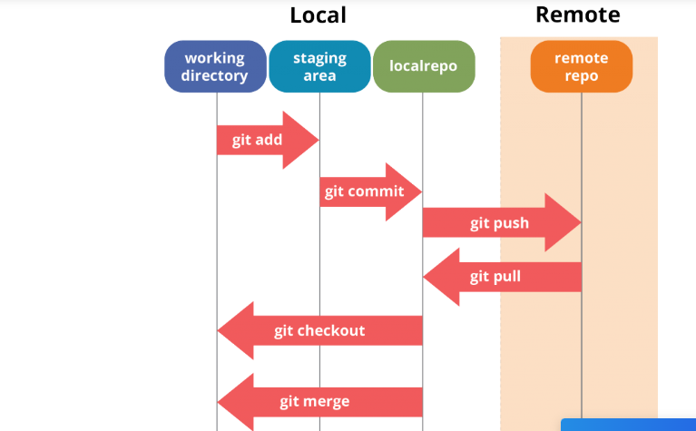
Take a look at the architecture of Git below:

Slide 10
If you understand the above diagram well and good, but if you don’t, you need not worry, I will be explaining these operations in this Git Tutorial one by one. Let us begin with the basic operations.
What is Git Bash used for?
This Git Bash focuses on the commands and operations that can be used on Git Bash.
Note: The commands cannot be executed on GitHub.
How do I navigate Git Bash?
After installing Git in your Windows system, just open your folder/directory where you want to store all your project files; right click and select ‘Git Bash here’.

Slide 11
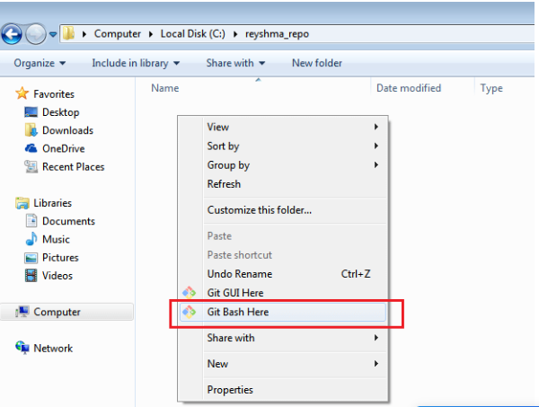

Slide 12
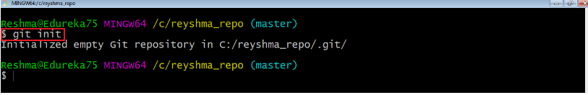
This will open up Git Bash terminal where you can enter commands to perform various Git operations.
Now, the next task is to initialize your repository.
Initialize
In order to do that, we use the command git init. Please refer to the below screenshot.

Slide 13

git init creates an empty Git repository or re-initializes an existing one. It basically creates a .git directory with sub directories and template files.
Running a git init in an existing repository will not overwrite things that are already there. It rather picks up the newly added templates.
Now that my repository is initialized, let me create some files in the directory/repository. For e.g. I have created two text files namely edureka1.txt and edureka2.txt.

Slide 14
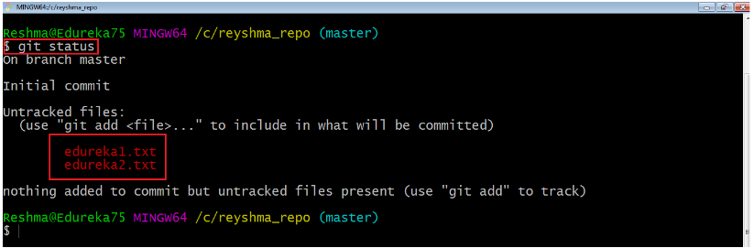
Git status
The git status command lists all the modified files which are ready to be added to the local repository.
Let us type in the command to see what happens:

Slide 15
Add
This command updates the index using the current content found in the working tree and then prepares the content in the staging area for the next commit.
Thus, after making changes to the working tree, and before running the commit command, you must use the add command to add any new or modified files to the index. For that, use the commands below:
git add <directory>
Or
git add <file>

Slide 16
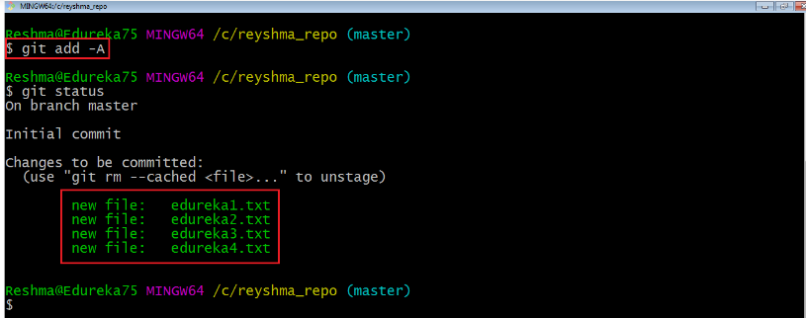
Let me demonstrate the git add for you so that you can understand it better.
I have created two more files edureka3.txt and edureka4.txt. Let us add the files using the command git add -A. This command will add all the files to the index which are in the directory but not updated in the index yet.

Slide 17
Now that the new files are added to the index, you are ready to commit them.
git commit
This will commit the staged snapshot and will launch a text editor prompting you for a commit message.
git commit -m “<message>”
Pull
The git pull command fetches changes from a remote repository to a local repository. It merges upstream changes in your local repository, which is a common task in Git based collaborations.
But first, you need to set your central repository as origin using the command:

Slide 18
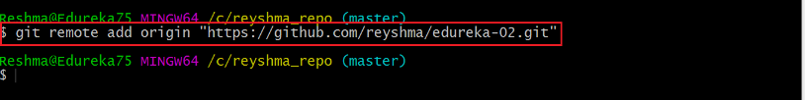
But first, you need to set your central repository as origin using the command:
git remote add origin <link of your central repository>
Now that my origin is set, let us extract files from the origin using pull. For that use the command:
git pull origin master

Slide 19
This command will copy all the files from the master branch of remote repository to your local repository.
Step 1: What is Github?
it is a file or code-sharing service to collaborate with different people.
GitHub is a highly used software that is typically used for version control.
It is helpful when more than just one person is working on a project. Say for example, a software developer team wants to build a website and everyone has to update their codes simultaneously while working on the project.
In this case, Github helps them to build a centralized repository where everyone can upload, edit, and manage the code files.

Slide 20
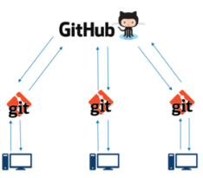
If you look at the image above, GitHub is a central repository and Git is a tool which allows you to create a local repository. Now people usually get confused between git and GitHub but its actually very different.
Git is a version control tool that will allow you to perform all kinds of operations to fetch data from the central server or push data to it whereas GitHub is a core hosting platform for version control collaboration. GitHub is a company that allows you to host a central repository in a remote server.

Slide 21
Now let me list down the ways in which GitHub makes git simple:
GitHub provides you a beautiful visual interface which helps you to track or manage your version controlled projects locally.
Once you register on GitHub, you can connect with social network and build a strong profile.
Step 2: How to create a GitHub Repository?
A repository is a storage space where your project lives. It can be local to a folder on your computer, or it can be a storage space on GitHub or another online host. You can keep code files, text files, images or any kind of a file in a repository.
You need a GitHub repository when you have done some changes and are ready to be uploaded. This GitHub repository acts as your remote repository. So let me make your task easy, just follow these simple steps to create a GitHub repository:

Slide 22
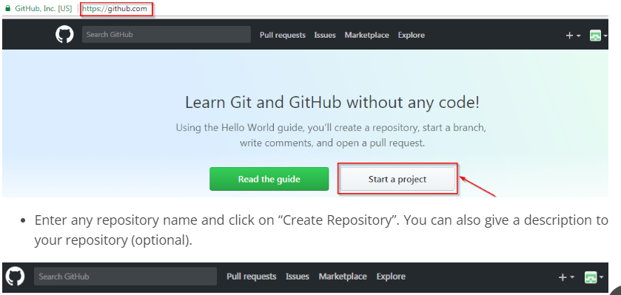
Go to the link: https://github.com/ . Fill the sign up form and click on “Sign up for Github”.
Click on “Start a new project”.

Slide 23
END THANK YOU

